Slide 1
Tuning the knobs of neural networks using Bayesian Optimization
Niall Turbitt

Slide 2
About me
Machine Learning Engineer @ Argos
Previously
Data Scientist @ Lucidworks
Masters in Statistics @ UCD Dublin
Mathematics & Economics @ Trinity College Dublin
https://github.com/niallturb/pylondinium18

Slide 3
What this talk will cover
Overview of neural networks
Convolutional Neural Networks
The hyperparameter tuning problem
Bayesian Opitimization
Fashion MNIST demo

Slide 4
Neural Networks – Brief Overview

Slide 5
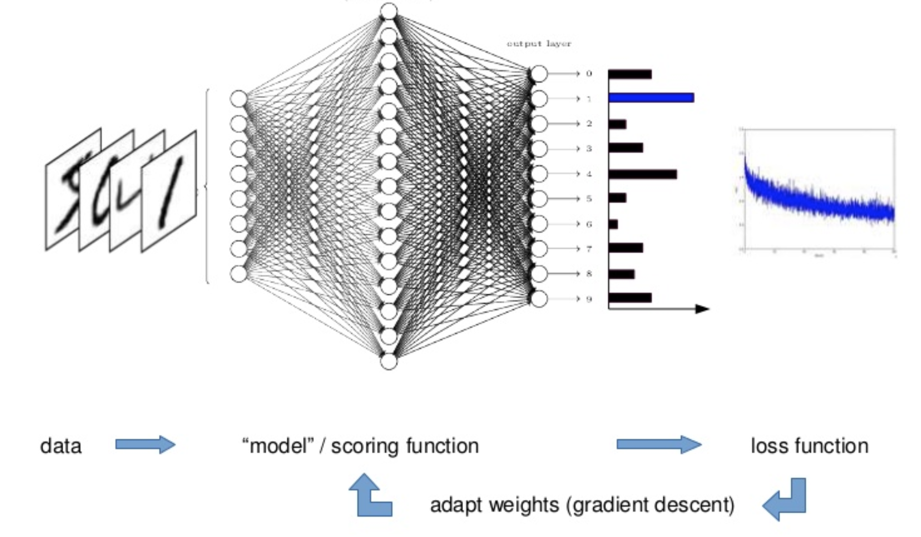
Training a Neural Network
Notes:
Basic neural network, been around since the 1960s
Example of fitting a neural network to MNIST dataset of handwritten digits between 0 and 9
Image coming in and some prediction coming out - 10 different classes for each digit between 0 and 9 with some assigned probability for the predicted value
When you train this, the neural network algorithm is iterating over the whole data and adapting weights of the neurons by some kind of back propagation or gradient descent, whilst logging some kind of loss
Ideally your loss goes down – model getting better at correctly identifying the images
See the loss converge - indicate model has finished training
Ideal

Slide 6
Training should converge
Notes:
Ideally we want to achieve something that looks like this
Accuracy which is the converse of the loss – which we want to maximize
Both plots converge

Slide 7
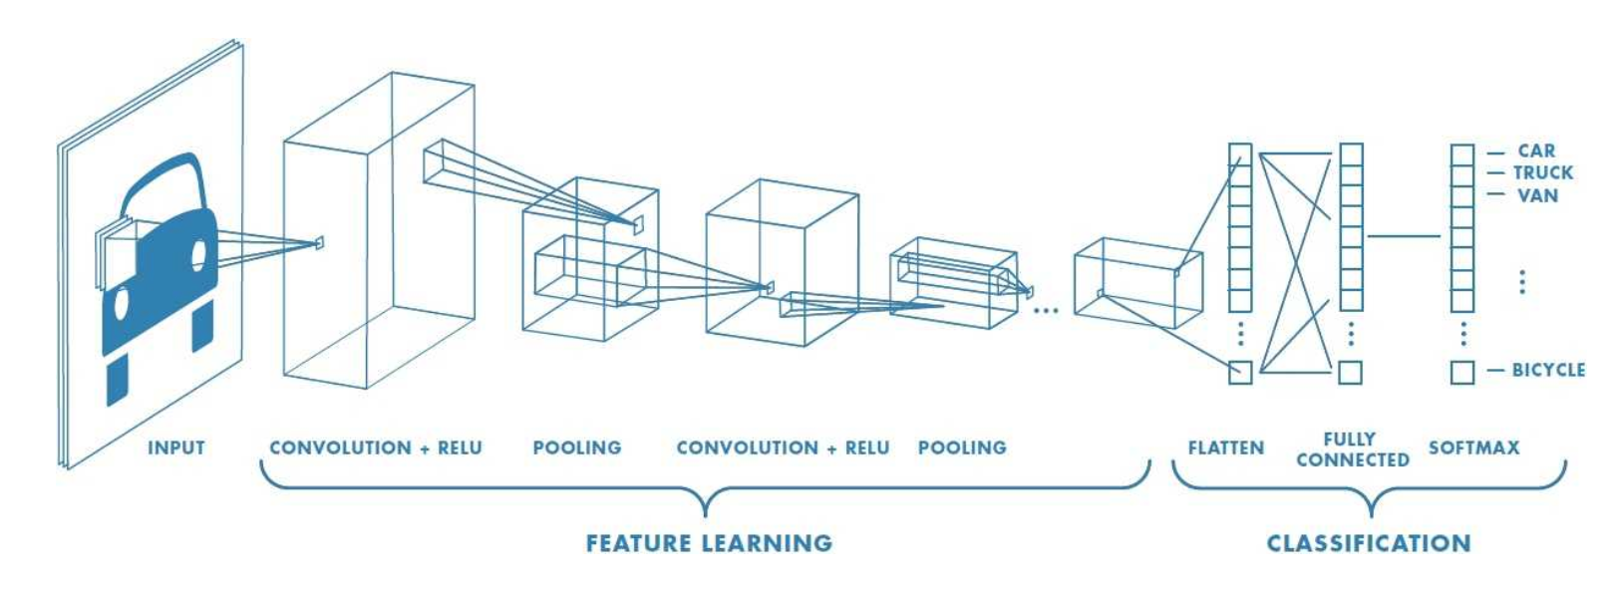
Convolutional Neural Networks (CNNs)
Notes:
With that high level view of how a generic neural network works in mind
Look at a specific category of neural networks that have proven very effective in area such as image recognition and classification

Slide 8

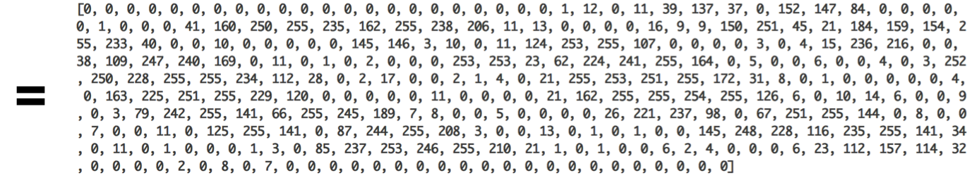
How can we input image data?
Notes:
Sticking with our example of MNIST handwritten digits, we can illustrate how we can use image data
Effectively, any image can be represented as a matrix of pixel values
Here we have our grayscale (black and white) handwritten 8
We have an 18 x 18 grid of pixel values, each of which ranges from 0 to 255 – 0 indicating white, 255 indicating black

Slide 9
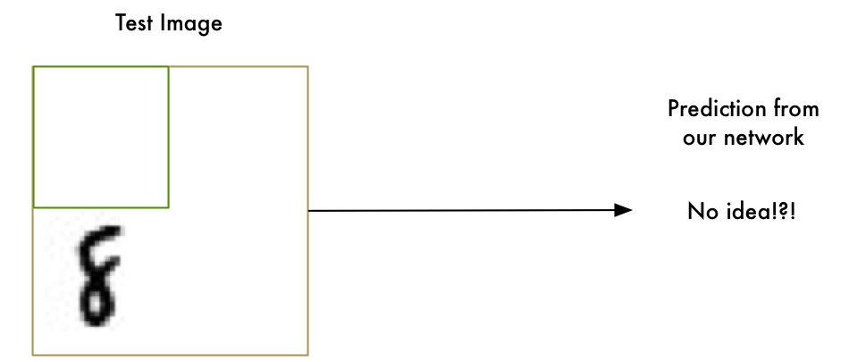
Tunnel Vision
Notes:
Traditionally, one major problems with neural networks was that if our model was only trained on digits which are perfectly centred , our model would do really well on simple images which the digit is right in the middle of the image
However, it would fail to identify any digit which wasn’t perfectly centred
Caveat to this is that there are brute force ways to combat this with traditional neural networks
Add more layers
Augment our input
A smarter way to approach this

Slide 10
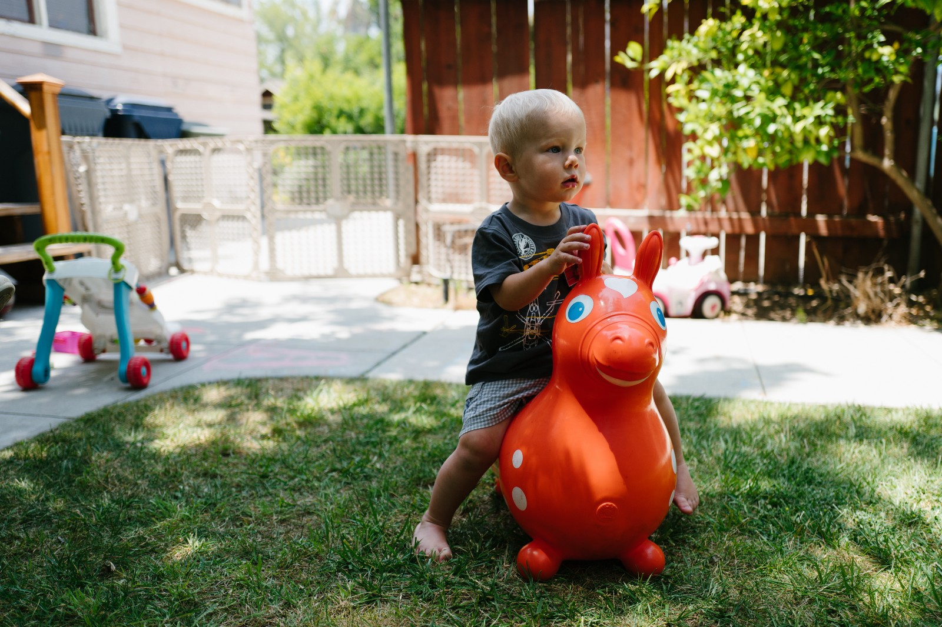
Convolution is the solution
Notes:
As a human you automatically recognize the hierarchy in this picture
The ground is grass and concrete
There is a child in the picture
The child is on a bouncy horse
The bouncy horse is on top of the grass
Important thing here is that we recognize the idea of a child no matter what surface the child is on
Don’t have to re-learn the concept of a child for every possible surface it could appear on
Basic neural networks can’t do this
Think that an 8 in a different part of the image is an entirely different thing
Doesn’t understand that moving an object around in the picture diesnt make it something different
Means we have to re-learn the identify of each object in every possible position
Need to give model understand on translation invariance
An 8 is an 8 not matter where in the picture it shows up

Slide 11
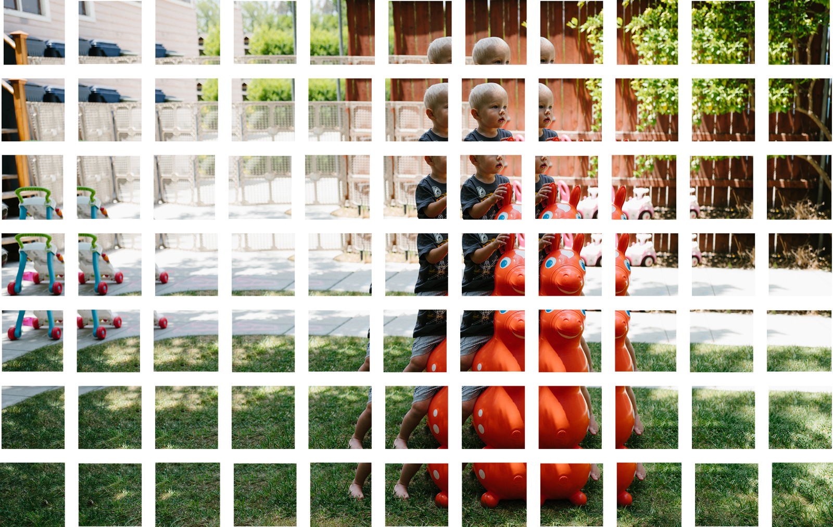

How Convolution Works
Notes:
Convolution works essentially as a sliding window over the entire original image
Condensing the data down

Slide 12
Notes:
Processing pipeline is a series of steps
Convolution
Max pooling – down sample and condense what we have learned
Finally fully connected network
The algorithm develops concepts of what it sees at each layer
High level concepts at earlier layers and more granular concepts at lower layers
Basic idea to start with large image and continually boil it down, step by step
More convolutions you have, the more complicated features your network will be able to learn to recognize
Example:
Learn to recognize round edges
Recognize car wheel using knowledge of round edges
Recognize car using knowledge of wheels etc

Slide 13
Constructing the right CNN
Number of layers
Number of convolution filters
Learning rate
Number of epochs
Batch size
Activation function
Weight initialization
Dropout rate
Notes:
All these options in each layer – multitude of hyperparameter settings at each layer
Constructing the right network traditionally involves a lot of experimentation and testing
Helped with expert knowledge into what hyperparameter configurations work
Lot of trial and error
Hyperparameter settings then are our model’s magic numbers – values that we set before we train with any data
In some cases, tweaking the values of the hyperparameters by just a small amount can have a huge impact on the performance of the model

Slide 14
Hyperparameter tuning
Grid Search
O(n^{k})
Random Search (Bergstra & Bengio, 2012)
Bayesian Optimization
Notes:
How do we find those optimal settings to get the best possible model?
Process by which we search for the best hyperparameters is known as hyperparamter optimization
Powerful tool to unlock the maximum potential of our model
Tuning hyperparameters for deep neural networks is tricky as models are slow to train, along with the number of possible configurations
Two most common approaches to sampling search candidates
Leave something to be desired
Grid search - Take a difficult time consuming problem and try to solve it by exhaustive brute force
Grid over the space of possible hyperparameters
Exhaustively search all hyperparamter combinations for the given values
Suffers from curse of dimensionality
Search space grows exponentially with the number of hyperparameters
Random search – works fast and better most of the time
Sample a given number of candidates from a parameter space with a specified distribution
Simple solutions – embarrassingly parallel
Is there anyway we can use our historical loass function observations
Make a more informed choice about future hyperparam configs

Slide 15
Bayesian Optimization
Notes:
Entire field of statistics dedicated to Bayesian Optimization
Keep light on the maths
Cover fundamentals to build an intuition around the framework

Slide 16
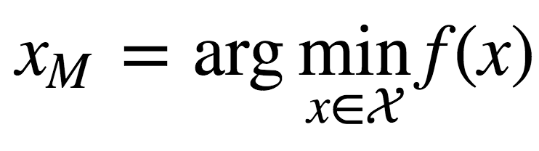
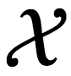
Bayesian Optimization
Tool for globally optimizing objective functions which are costly or slow to evaluate
Sequential model-based optimization (SMBO)
Initialize a Gaussian Process on a small set of samples from our domain, to compute a prior probability model
Sequentially select new locations within the domain by optimizing some acquisition function
At each iteration, we update our belief of what our objective function f looks like, having computed the loss for a new configuration of hyperparameters.
Notes:
In the case of neural networks, extremely pertinent due to the length of time one network can take to train
Falls into class of optimization algorithms called SMBO
Sequential – leverage historical info to decide what to do next
Model-based – build surrogate functions to understand the response surface
Optimization – use that surrogate function to decide the next optimal configuration
We are building a stochastic repsonse surface for what we think is going to happen when we try different parameters
Now that I have this idea of what’s going to happen if I try different configurations, what’s the next most intelligent configuration

Slide 17
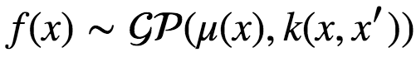
Gaussian Process
A Gaussian Process is the generalization of a Gaussian distribution to a distribution over functions
Induces a posterior distribution over the loss function that is analytically tractable
Notes:
f is a sample from a Gaussian Process with mean and covariance function
Just as a Gaussian distribution is completely specified by it’s mean and variance
GP fully parameterized by a mean and covariance function k
Covariance function characterizes the smoothness and other properties of our loss function
The kernel of the GP
Has to be continuous, symmetric and positive definite
Gaussian process popular – induces a posterior distribution over the loss function that is analytically tractab;e
Allows us to update our beliefs of what f looks like, after we have computed the loss for a new set of hyperparams

Slide 18
Acquisition Function
Surrogate function that represents our beliefs of
Expected Improvement
Upper Confidence Bound (UCB)
Maximum probability of improvement (MPI)
Exploration/Exploitation trade off
Notes:
To find the best point to sample from our domain, we will choose the point that maximizes the acquisition function
Function of the posterior distribution over f, that describes the utility for all values of the hyperparameters
Values with the highest utility will be the values for which we compute the loss next
If we maximize expected improvement, we will either
Sample from points which we expect a lower value for our loss function
Sample from points of a region we havent explored yet
Explore – look at areas with high variance
Exploit – probe points near the current known maximum
It is this cheap proxy function that we optimize

Slide 19
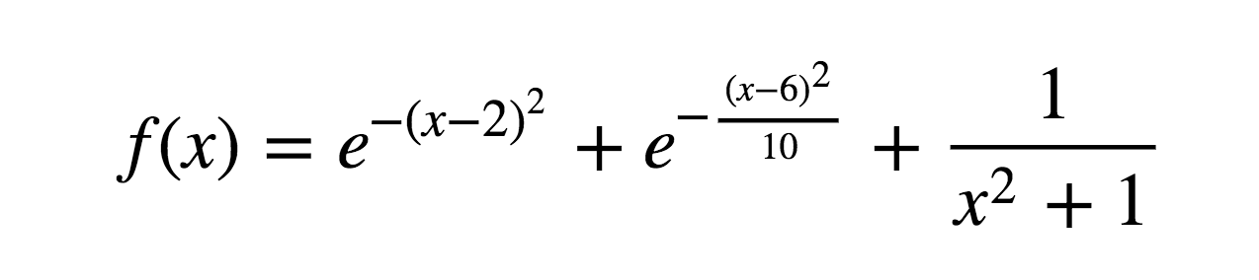
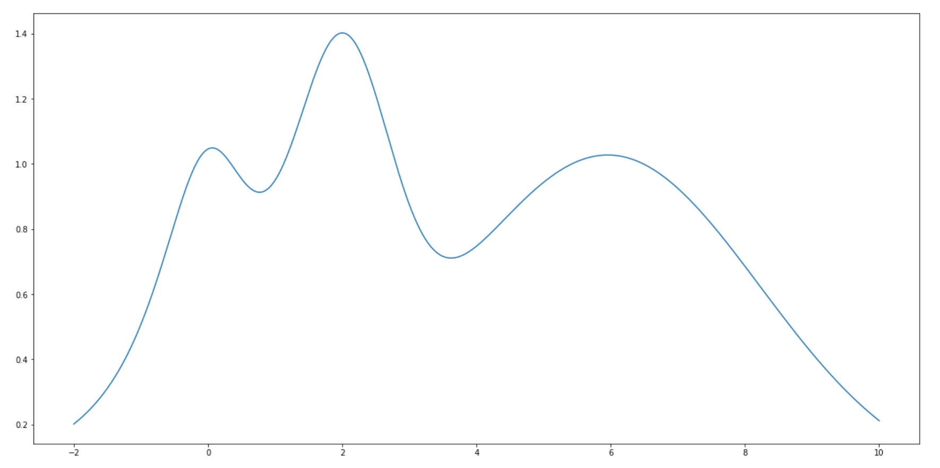
One Dimensional Bayesian Optimization Example
https://github.com/niallturb/pylondinium18/blob/master/basic_bayes_opt_demo.ipynb
Notes:
Target function we want to optimize
Maximum at x = 2, we’ll restrict the interval between -2 and 10
Important to note that in practice we do not know this function
Only information we obtain is through sequentially probing it at different points

Slide 20
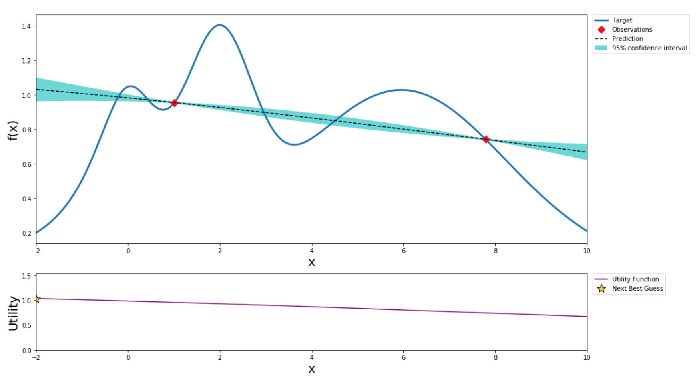
Initialize with 2 random points
Notes:
Sample two points to initialize the algorithm
The larger the initial set of random points explored, the less likely the algorithm is to get stuck I local minima due to being too conservative

Slide 21
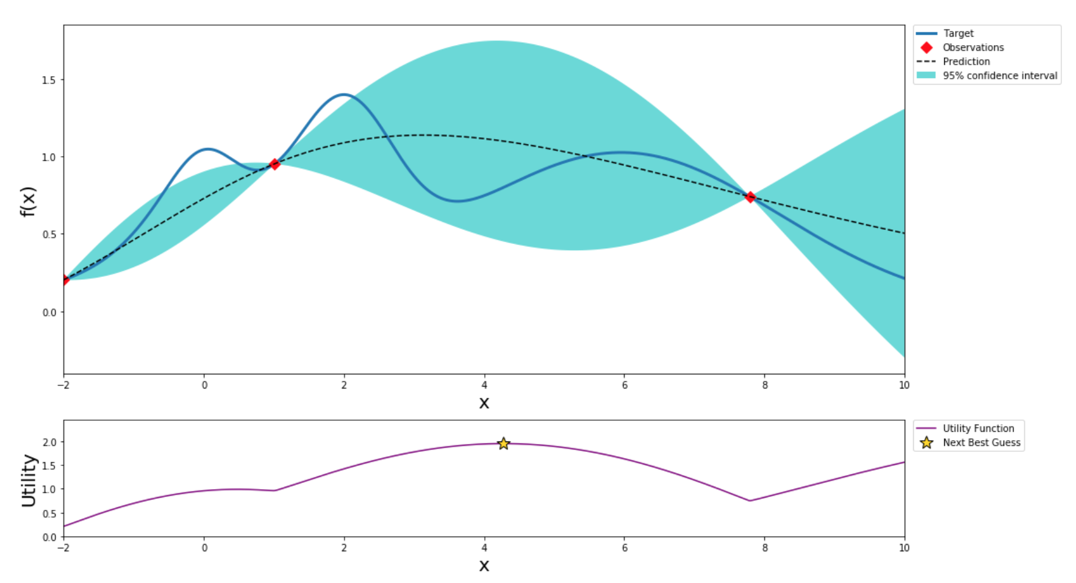
After 1 step of GP (and two random points)

Slide 22
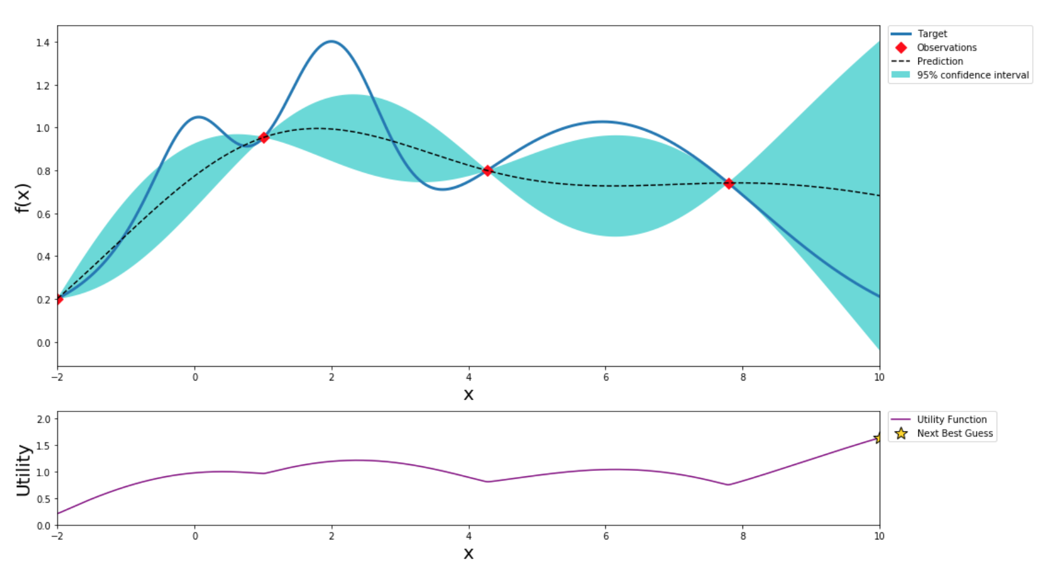
After 2 steps of GP (and two random points)

Slide 23
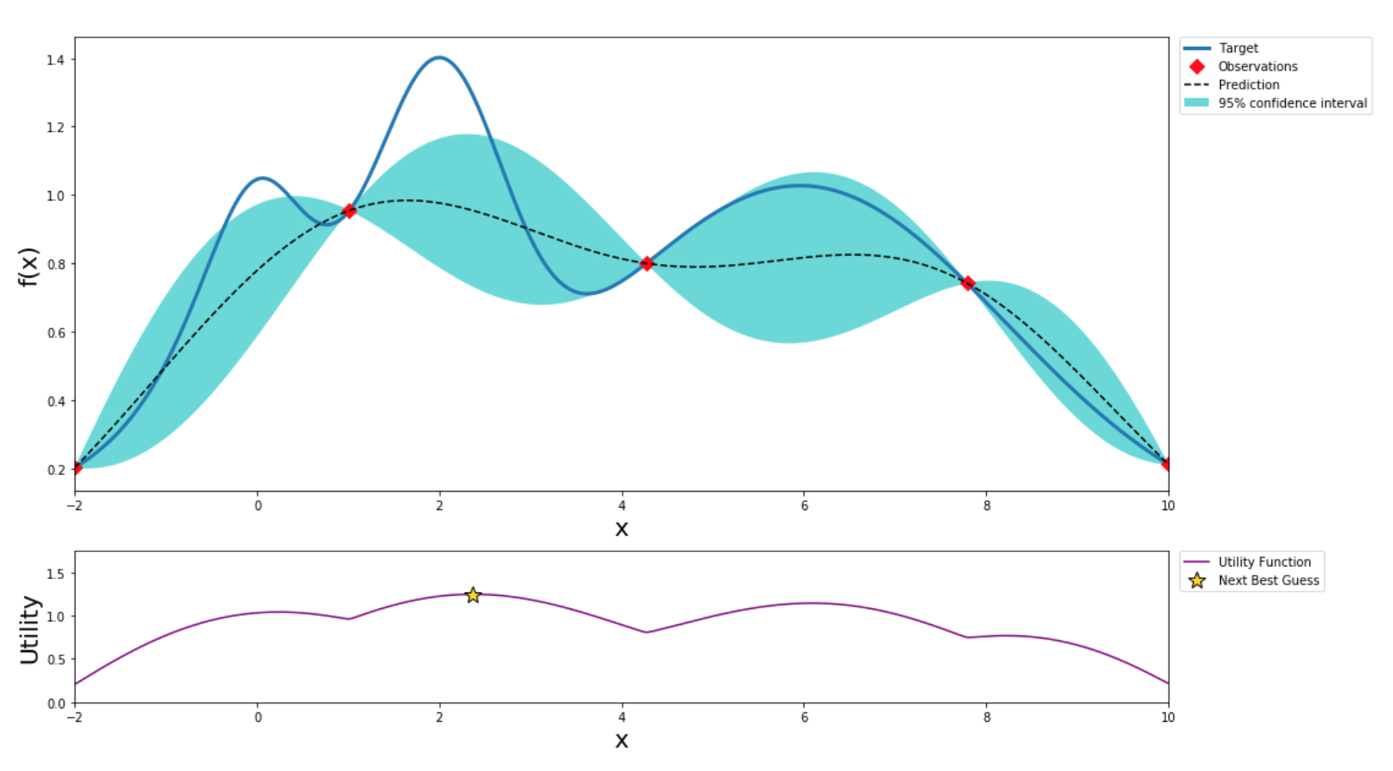
After 3 steps of GP (and two random points)

Slide 24
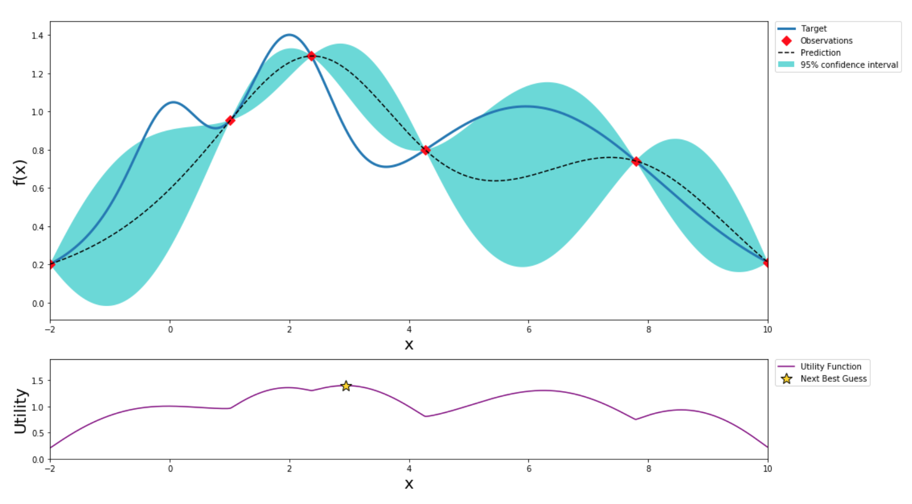
After 4 steps of GP (and two random points)

Slide 25
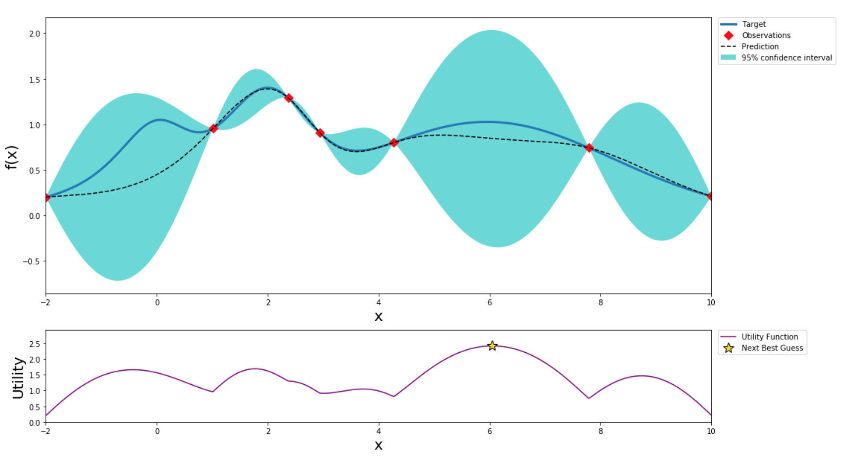
After 5 steps of GP (and two random points)

Slide 26
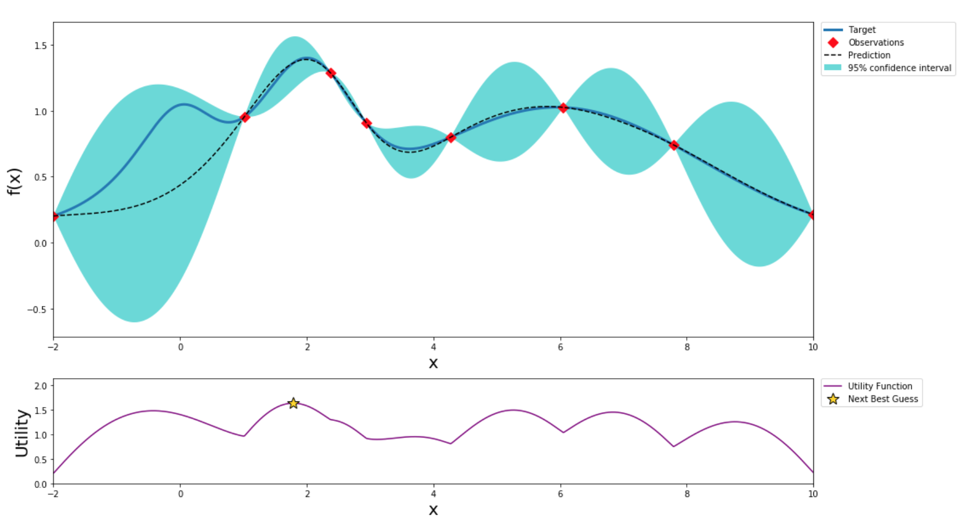
After 6 steps of GP (and two random points)

Slide 27
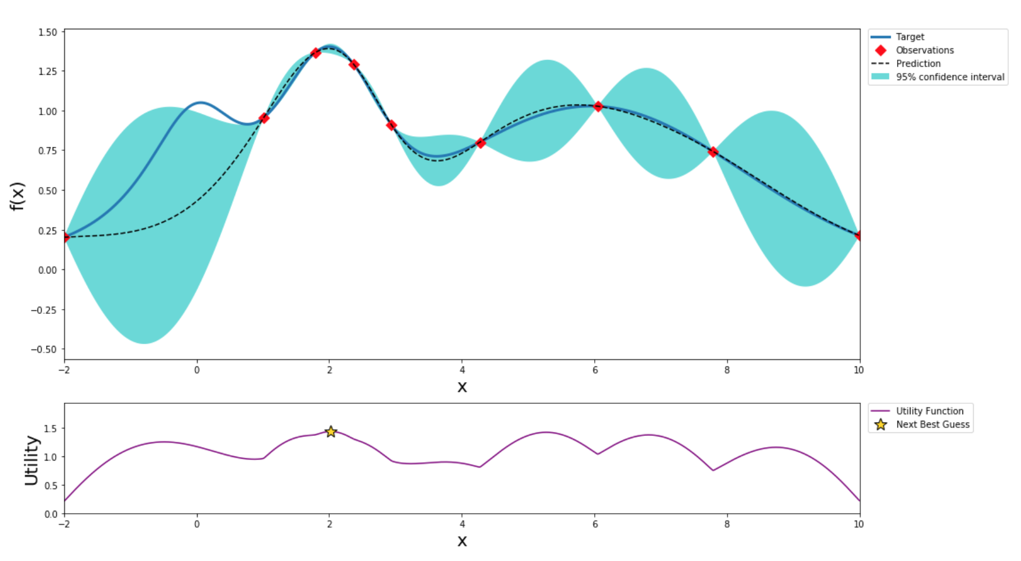
After 7 steps of GP (and two random points)

Slide 28
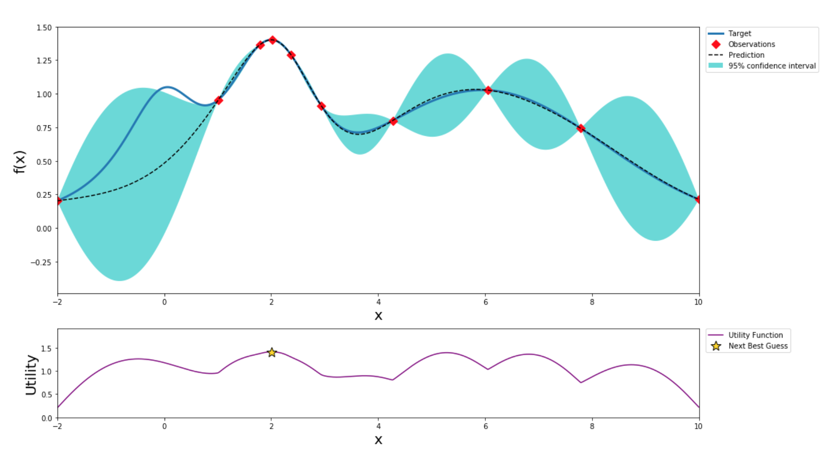
After 8 steps of GP (and two random points)

Slide 29
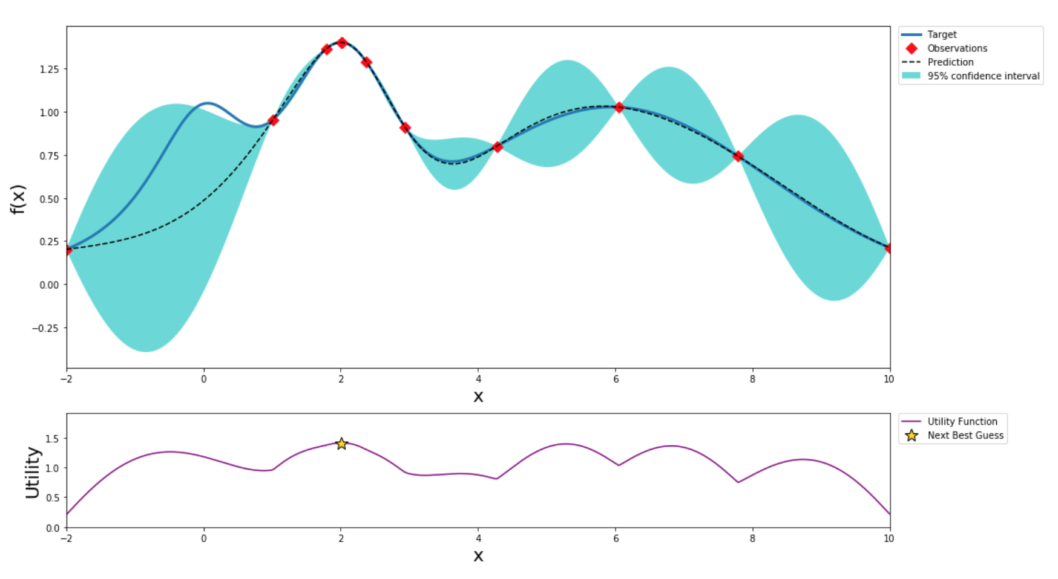
After 9 steps of GP (and two random points)

Slide 30
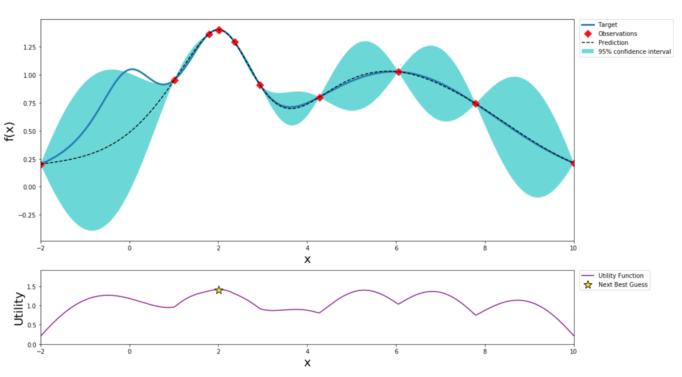
After 10 steps of GP (and two random points)

Slide 31

After 11 steps of GP (and two random points)

Slide 32
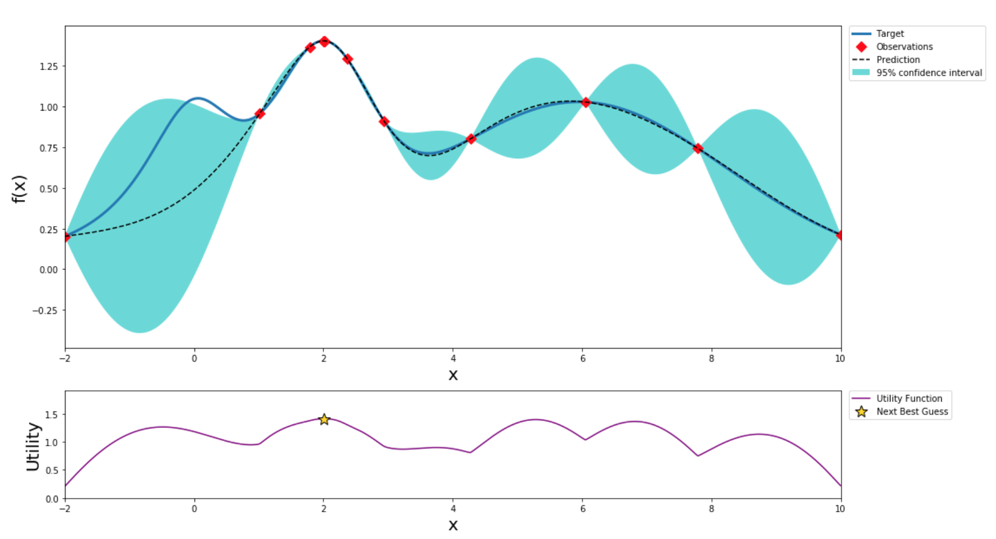
After 12 steps of GP (and two random points)
Notes:
After 12 points the algorithm was able to get pretty close to the true maximum

Slide 33
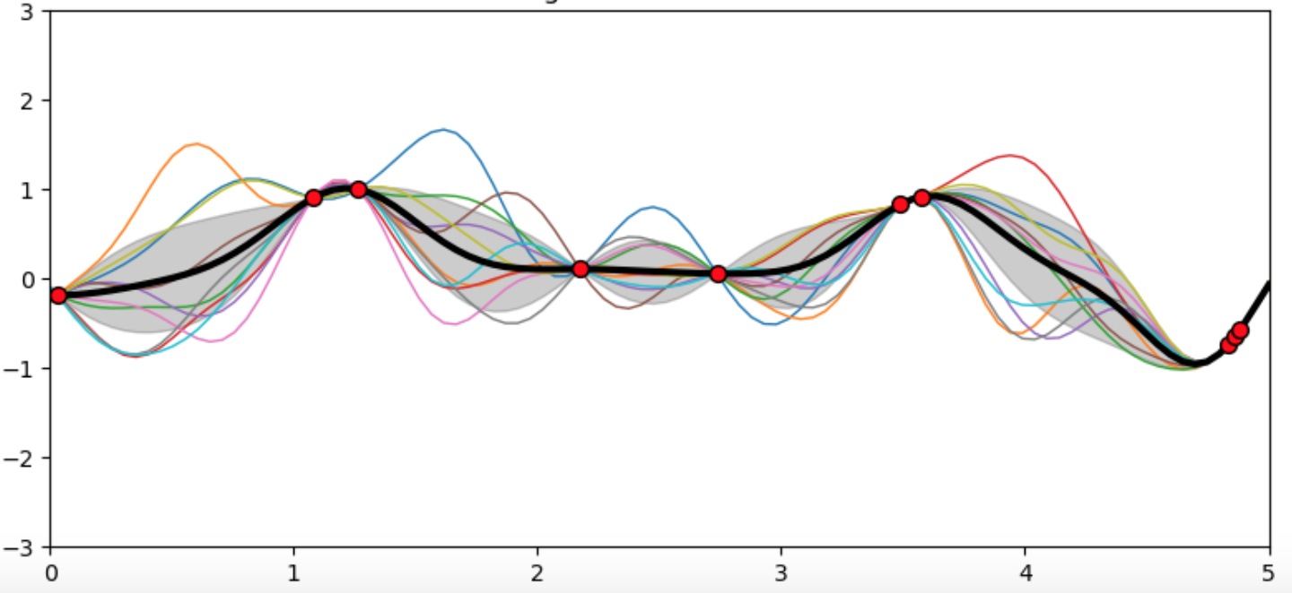
Functional Perspective

Slide 34
Fashion MNIST Demo
Notes:
Putting this all together

Slide 35
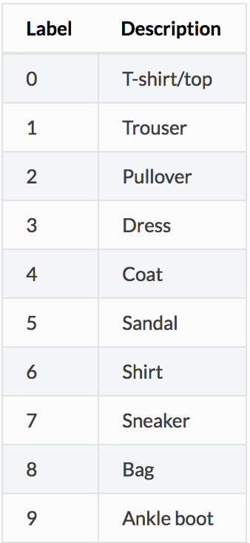
Fashion MNIST Dataset
60,000 training examples
10,000 test examples
Each example is a 28x28 grayscale image
10 label classes
Intended replacement for the original MNIST dataset
https://github.com/zalandoresearch/fashion-mnist
Notes:
Original MNIST a large set of handwritten digits uses for training and benchmark in machine learning
MNIST now too easy
Overused
Can not represent modern computer vision tasks

Slide 36
Demo
https://nbviewer.jupyter.org/github/niallturb/pylondinium18/blob/master/fashion_mnist_bayes_opt.ipynb

Slide 37
References
Snoek et al., 2012 - Practical Bayesian Optimization of Machine Learning Algorithms
http://papers.nips.cc/paper/4522-practical-bayesian-optimization-of-machine-learning-algorithms.pdf
Bergstra & Bengio, 2012 – Random Search for Hyperparamter Optimization
http://www.jmlr.org/papers/volume13/bergstra12a/bergstra12a.pdf
Rasmussen & Williams, 2006 – Gaussian Processes for Machine Learning
http://www.gaussianprocess.org/gpml/
François Chollet, 2017 - Deep Learning with Python
https://www.manning.com/books/deep-learning-with-python

Slide 38
Thank you
Questions?

